Slide 1
Security Verification Using the
Chisel Hardware Construction Language
Corine Lu
Jakub Szefer
Computer Architecture and Security Lab
Yale University
14 July 2017

Slide 2
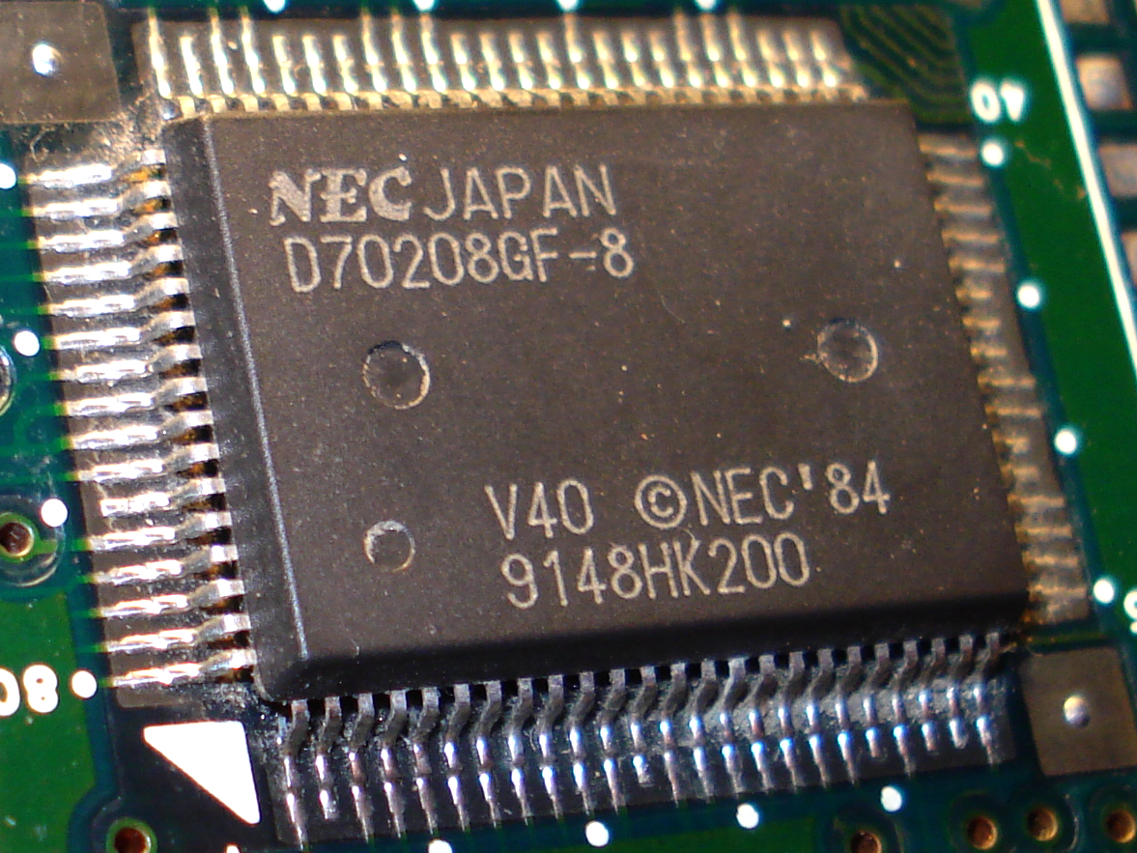
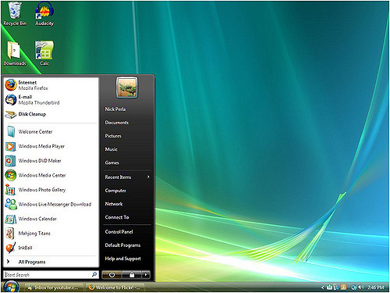
Computer Architecture
Microprocessor
Stores and accesses data
Acts as central processing unit
Hardware
Operating System
User interface
Allows interaction with microprocessor
Software
Notes:
Center subtitles, more descriptive

Slide 3
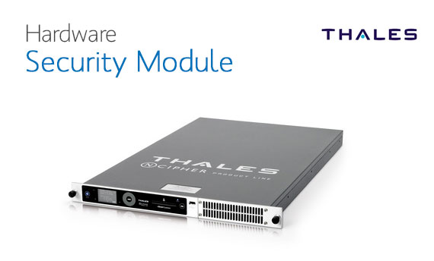
Security Issues
Scan and monitor network traffic
Hardware firewalls
Cryptographic keys for encryption
Essential for software
Lowest level of security
Especially important in critical infrastructures
Very hard to patch hardware issues after manufacturing
Notes:
Issues with software, application, OS, compromised
Hardware run with software, need to make sure software is secure, need both
Examples of what I’m trying to improve
Truncate my half
More descriptive title

Slide 4
Security Verification Approach
Objective: Prove a system is secure during design stages
Focus on information flow, sensitive information leaking
Improve functionality
Chisel Hardware Construction Language
Software supporting hardware design
Creates abstractions and generates parameters
Modifying Chisel => SecChisel with security tagging
Notes:
One approach is info flow
Used to check if sensitive info is leaking
Improve functionality - move it to the first bullet
Truncate the language one
Just chisel and talk about objective

Slide 5
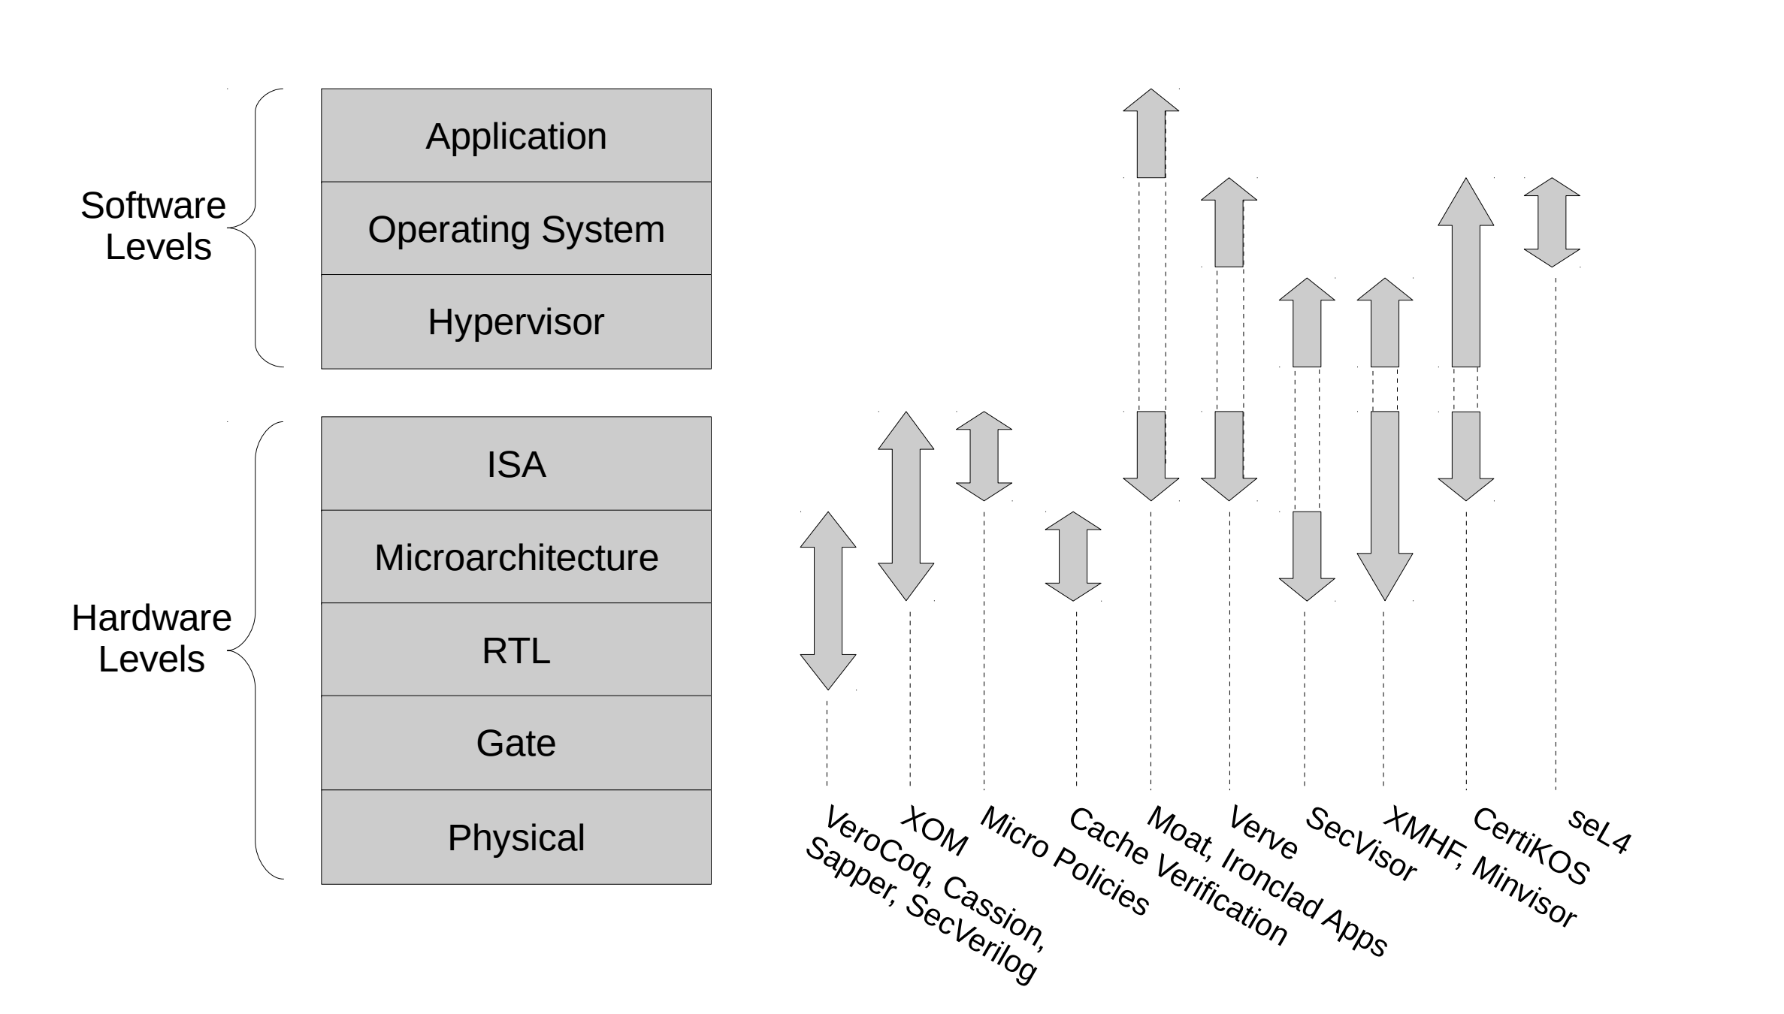
System Verification at Multiple Levels

Slide 6
Hardware Security Verification
Security Properties
System Representation
Formal
Verification
Notes:
Security Properties are appropriate standards to meet to be considered secure
System Representation accurately represents the behavior of the system using SecChisel
Formal Verification is proving or disproving whether the system meets the security properties

Slide 7
Formal Verification
Proving or disproving statements in SecChisel
Must convert code
Run it through SMT (Satisfiability Modulo Theory) Solver
Takes assertions (security properties) and rules (system representation)
Satisfied vs. Unsatisfied
Issues with speed
Notes:
Condense with previous slide

Slide 8
Optimizing Formal Verification
Code:
File representing security parameters and design
Altering the code fed into the SMT Solver
Using less expensive functions
Procedures that take less time to run
Ignore some instructions and/or merge
SMT Solver:
Variety of solvers
Z3 is currently most popular
Made by Microsoft
Widely-used
Looking for other solvers that better fit the needs of SecChisel

Slide 9
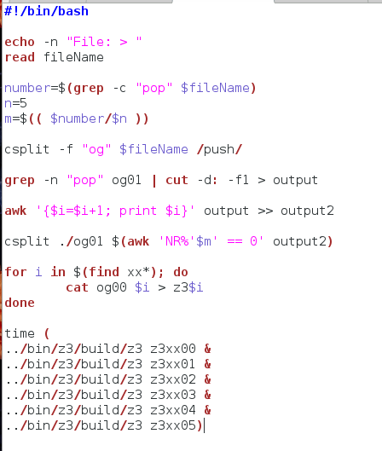
Optimizing Program Execution
Alters how the code is run by the machine
Sequential progression vs. parallel
100,000 vs. 10,000 * 10
Notes:
Variety of smt solvers
Then go into z3, most popular
Add description of algorithm and approach
Adding actual script
Add any data and run times
Sample z3 file and how to split it

Slide 10
Scripts
Script is a series of commands; code
Scripts that parse through the code and create separate files to be run in parallel
Split into two parts: assumptions and rules
Every file has assumptions
Split up rules in intervals
Notes:
Not clear it is methodology, make it more clear
Use picture

Slide 11
Average Seconds to Execute
Rules | 1 file (s) | 5 files (s) | 10 files (s)
119 | 0.0438 | 0.0172 | 0.0232
29 | 0.0380 | 0.0227 | 0.0230
Notes:
Change it to milliseconds

Slide 12
Average Seconds to Execute
Rules | 1 file (s) | 5 files (s) | 10 files (s)
119 | 0.0438 | 0.0172 | 0.0232
29 | 0.0380 | 0.0227 | 0.0230
-0.0266
-0.0206
-0.0153
-0.0150
Notes:
This is result
Able to get time to decrease using the methods
Should be a summary slide

Slide 13
Summary
Hardware security is the issue we seek to improve
Use SecChisel to look for security in the design phase
Formal verification to check if the the design satisfies security properties
Optimize formal verification
Analyze the results

Slide 14
Acknowledgements
Thank you to:
STARS Program - Yale College
Professor Moreno
Professor Nelson
Professor Purushothaman
Robert Fernandez
Computer Architecture and Security Lab
Jakub Szefer
Shuwen Deng

